Slide 1
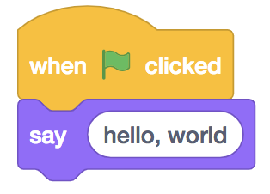
Problem Solving Approach
Week 2
Sumaiyah Zahid

Slide 2
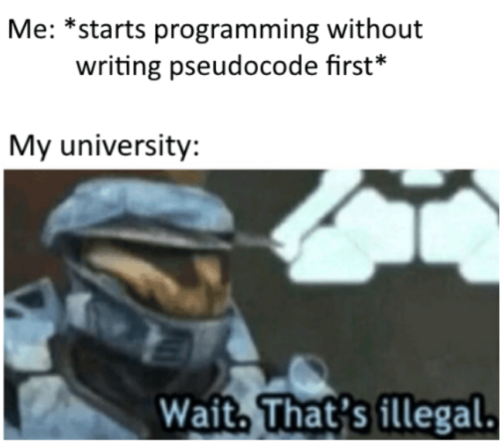
Start
Eat
Sleep
Code
If tired
Take a rest
End

Slide 3
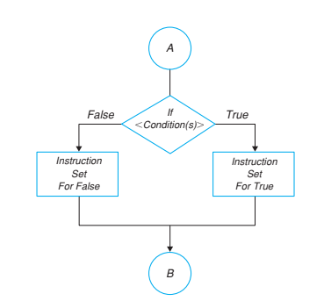
Decision Logic Structure If/Then/Else
Calculating the pay for an employee at an hourly rate and overtime pay (over 40 hours) at 1.5 times the hourly rate.

Slide 4
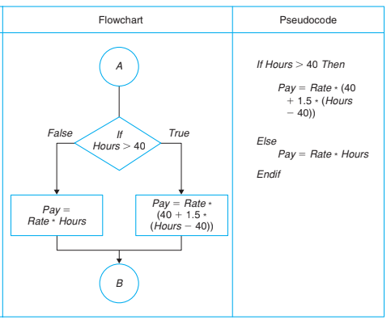

Slide 5
Nested If/Then/Else
Calculate the pay for an employee on the following conditions:
Fixed Salary or Hourly salary
For employees working on hourly salary, If working hours are greater than 40 hours, overtime would be paid at 1.5 times the hourly rate.

Slide 6
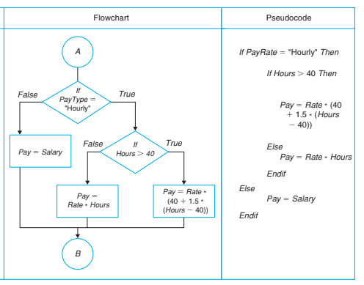

Slide 7

Make a flowchart for the charges of a train ticket based on the ages of people

Slide 8
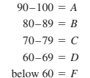
Practise Exercise
Make a flowcharts for calculating a student’s letter grade given the following
Write the Calculation module to choose the largest number from a set of three numbers A, B, and C. Write the pseudocode and draw the flowchart. Do not use the maximum function.
Joan is planning her vacation. She is considering two different destinations. She would like to go to the one that will be less expensive for the total trip including gas, hotel room for six nights, and meals for seven days. Write a solution to tell her which of the destinations would be the less expensive.
Monica needs to buy a present for her best friend. She can buy it online or she can travel 30 miles to buy at the store. She is not sure which would be less expensive considering shipping and handling costs to buy online and gas costs to travel to the store. The cost is the same in both places. Write a solution to tell Monica which would be the best way to buy the present.

Slide 9

Loop World
Start
Eat
Sleep
Code
Go to Line 2
End

Slide 10
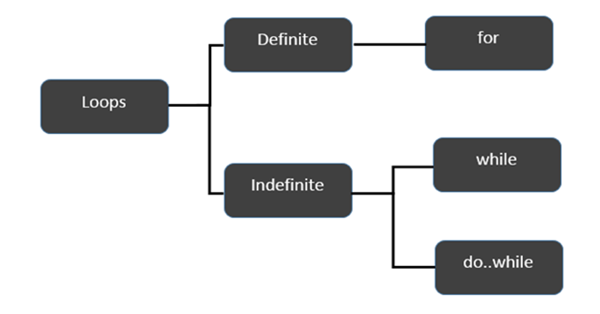
Loop Logic Structure

Slide 11

FUN with Lego

Slide 12
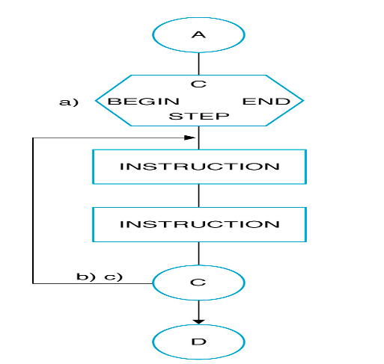
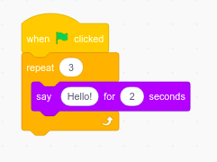
For Loop
For i=1 to n
Do something
Do something
End for

Slide 13
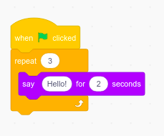
Print Hello World for 5 times.
Write a pseudocode and make a flowchart to read 10 numbers from keyboard and find their sum and average.

Slide 14
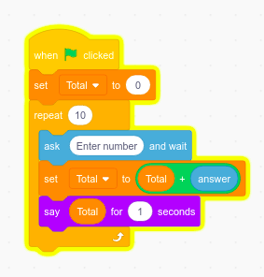
Write a pseudocode and make a flowchart to read 10 numbers from keyboard and find their sum and average.

Slide 15
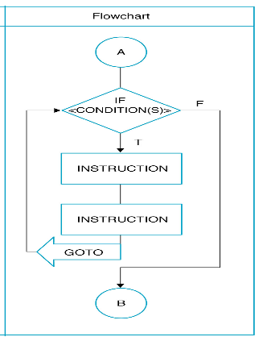
WHILE Loop

Slide 16
Start
While (In FAST)
Eat
Sleep
Code
End

Slide 17
Print Hello World for 5 times using While Loop.
Write a pseudocode and make a flowchart to read 10 numbers from keyboard and find their sum and average using while Loop.

Slide 18
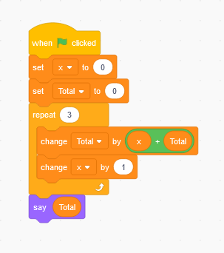
While Loop with an iterator
Make a flowchart for a program which calculates the sum of 100 integers 1, 2, 3, …, 100.
Set count to 0
Set total to 0
While (count<=100)
count=count+1
total=total+number
End while
Display total

Slide 19
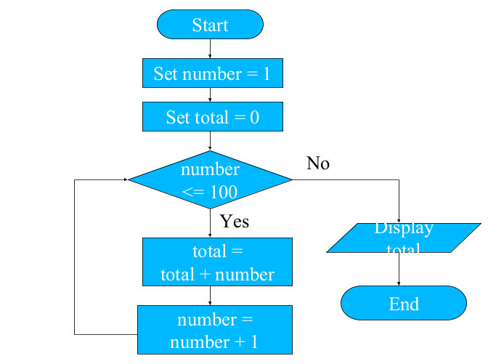

Slide 20
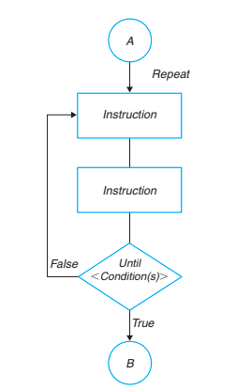
Do While Loop

Slide 21
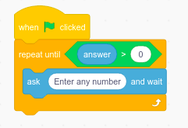
Do-While
Write a program to keep asking for a number until you enter a +ve number.
Start
Read a number
While (number < 0 )
Read a number / Go to Line 2
End while
Display positive number
End
Start
Do
Read a number
While (number < 0 )
End while
Display positive number
End

Slide 22
Problem
Make a flowchart for a program which ask the user for the password until it matches with the actual one.
Make a flowchart for a program which ask the user for the password. If it doesn’t match in 3 trials, it shouldn't ask again.

Slide 23
Home Assignment
Make a flowchart and write a pseudocode to print first 50 even numbers.
Make a flowchart and write a pseudocode to sum n numbers until sum < 40.
Make a flowchart and write a pseudocode to read an age of 15 person & find out how many of them fall under :
a) Still a baby- age 0 to 5
b) Attending school - age 6 to 17
c) Adult life-age 18 & over

